Slide 1
BIKE – SHARE ANALYTICS A CASE STUDY

Slide 2
BIKE SHARE CASE STUDY
You are a junior data analyst working in the marketing analyst team at Cyclistic, a bike-share company in Chicago. The director of marketing “Moreno” believes the company’s future success depends on maximizing the number of annual memberships. Therefore, your team wants to understand how casual riders and annual members use Cyclistic bikes differently. From these insights, your team will design a new marketing strategy to convert casual riders into annual members. But first, Cyclistic executives must approve your recommendations, so they must be backed up with compelling data insights and professional data visualizations.
Moreno has set a clear goal: Design marketing strategies aimed at converting casual riders into annual members. In order to do that, however, the marketing analyst team needs to better understand how annual members and casual riders differ, why casual riders would buy a membership, and how digital media could affect their marketing tactics. Moreno and her team are interested in analyzing the Cyclistic historical bike trip data to identify trends.

Slide 3
BUSINESS TASK
How to convert casual riders to annual members ?
To answer this understand how differently casual riders and annual members use their bikes.
Why casual members would buy annual memberships?
How digital media can affect marketing tactics?

Slide 4
EXECUTIVE SUMMARY
After cleaning the data :
Total Population = 84027.
CASUAL = 23495
MEMBERS = 60531
casual members make up 27.96% of the total population.
Each of the members have a unique ride_id. For analysis The members are segregated based on the duration of their journey.
Though mathematically distance is directly proportional to duration, still we analyze the two parameters separately.

Slide 5
RIDE DURATION
Of the users who use their bikes for hours, casual riders make up about 84% and in cases where ride durations are in days casual riders make up about 85%

Slide 6
A COMPARITIVE STUDY OF CYCLE USAGE

Slide 7
COMPARATIVE STUDY OF CYCLE DISTANCE
The data visualization shows the path between starting location and the destination of all the riders.
The map is segmented into two parts:
The left map shows casual riders and right map shows annual members
The users are further segregated via different colors based on their total distance covered.

Slide 8
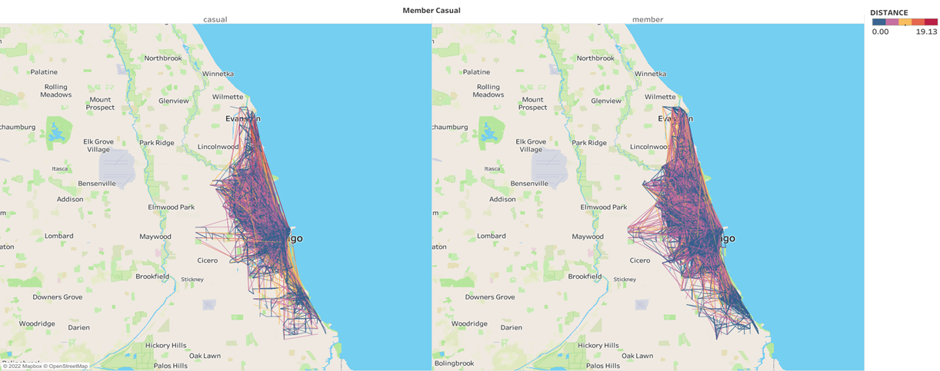
CASUAL
MEMBER

Slide 9
The next visualization shows the total number of riders when the distance is of the range 15.137 to a maximum of 19.131.
It is observed that number of casual users is more than the members.

Slide 10
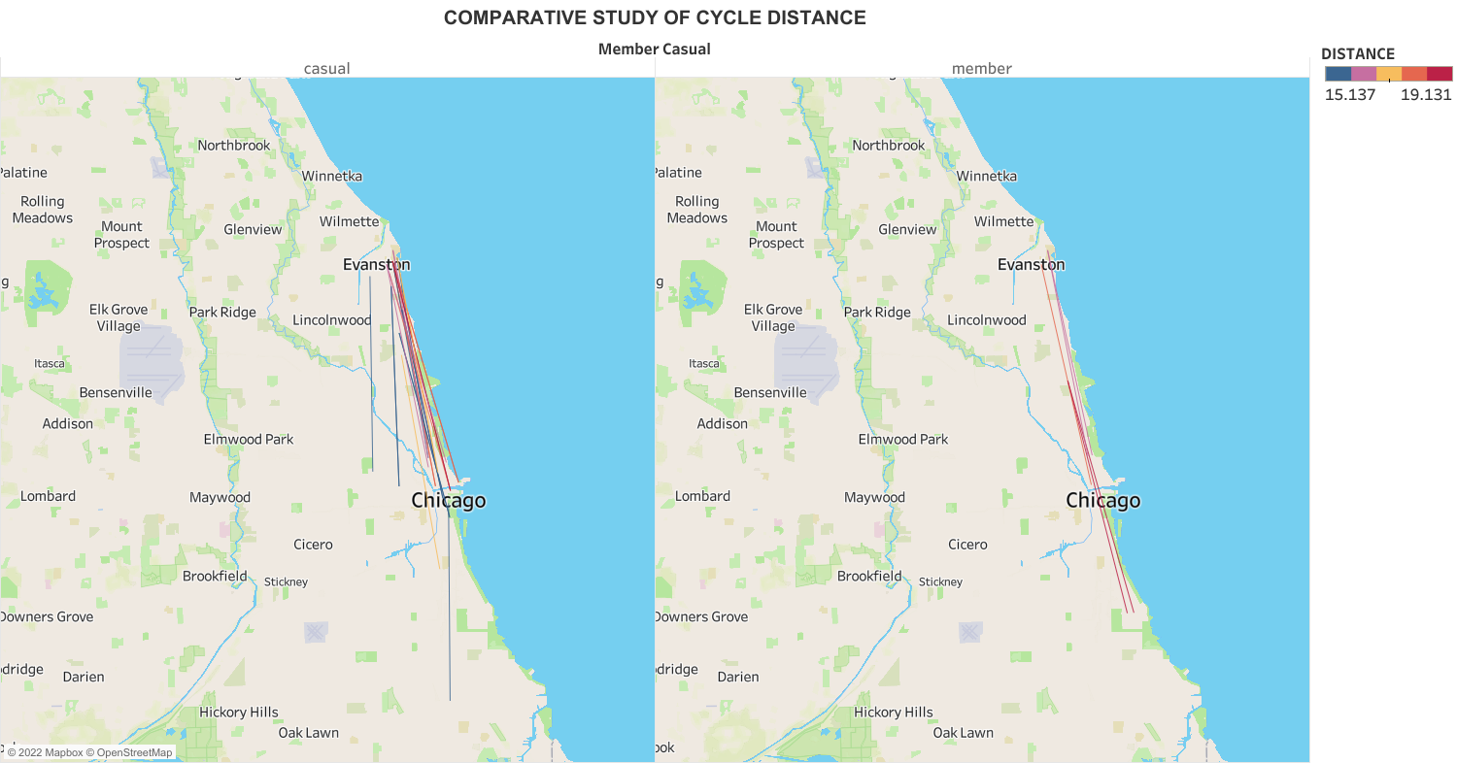
CASUAL
MEMBER

Slide 11
Distance vs Population(DIFF)
1. The graph is plotted between Distance and the difference in the number of Casual users and Members.
2. We observe that this difference decreases as the lower limit of the distance approaches the upper limit, indicating that the number of casual riders and members riding for longer distances are close to each other.
3. The difference becomes negative towards the end depicting that casual members travelling larger distances are more than the members.
The number of casual members travelling 10Km upwards is more than annual members.

Slide 12
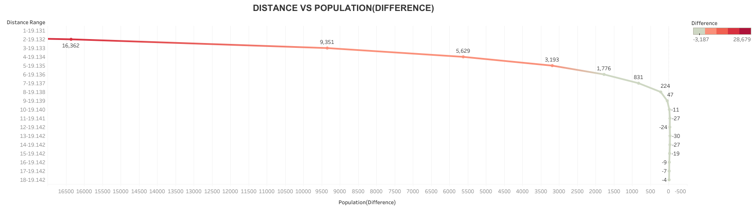

Slide 13
ANALYSIS SUMMARY AND RECOMMENDATIONS
Answering questions related to business task
How differently casual riders and annual members use their bikes?
A significant similarity can be seen in the usage of casual riders and annual members.
Casual members travelling to larger distances are more than the members.
In comparison to “members”, the number of “casual” users is significantly more when the duration for which bikes are utilized is in days .
Why casual members would buy annual memberships?
Being an annual member will make them eligible for plans and offers that can streamline their usage.
The sales team can even call them informing of their usage similarity to annual members. They can elucidate to them the various ways the members are benefiting from their annual memberships and how these plans will enrich their experience as well.
The casual members can be approached digitally on the app/website via notifications or email. These will support the previous point with interesting visuals and data visualizations.
.

Slide 14
How digital media can affect marketing tactics?
Digital media is a prominent means of reaching out to a larger population. The bike share program is meant for a;; kinds of people. Thus the marketing should be done separately for different groups of people.
A social media page can help attract theattention of teenagers and a younger audience
The older generation can be reached via newspapers.
A further analysis on the most popular podcasts and television shows categorized by age groups can help the company to create specific ads for target audience.
These ads can highlight the benefits of cycling like good health, environment-friendly to name a few.
For further analysis:
The data set should include the rider’s gender and age.

